Slide 1
DETECTION OF WRONG DIRECTION DRIVING VEHICLES (Computer Vision Project)
Name: Datta Sainath D
Net Id: dsd298
Professor: Guido Gerig
Course: CS 6643
New York University
Note: This project is completely modeled for left hand driving countries

Slide 2
CONTENTS
Motivation/ Problem Identification
Solution
Outline of this project
Detailed explanation of each step of image processing
Results
Case which fails and its solution

Slide 3
MOTIVATION / PROBLEM IDENTIFICATION
Major problem in developing countries like India:
A third of road accidents are caused by vehicles plying on wrong side
Source: https://timesofindia.indiatimes.com/city/delhi/a-third-of-road-accidents-caused-by-vehicles-plying-on-wrong-side/articleshow/59623945.cms

Slide 4
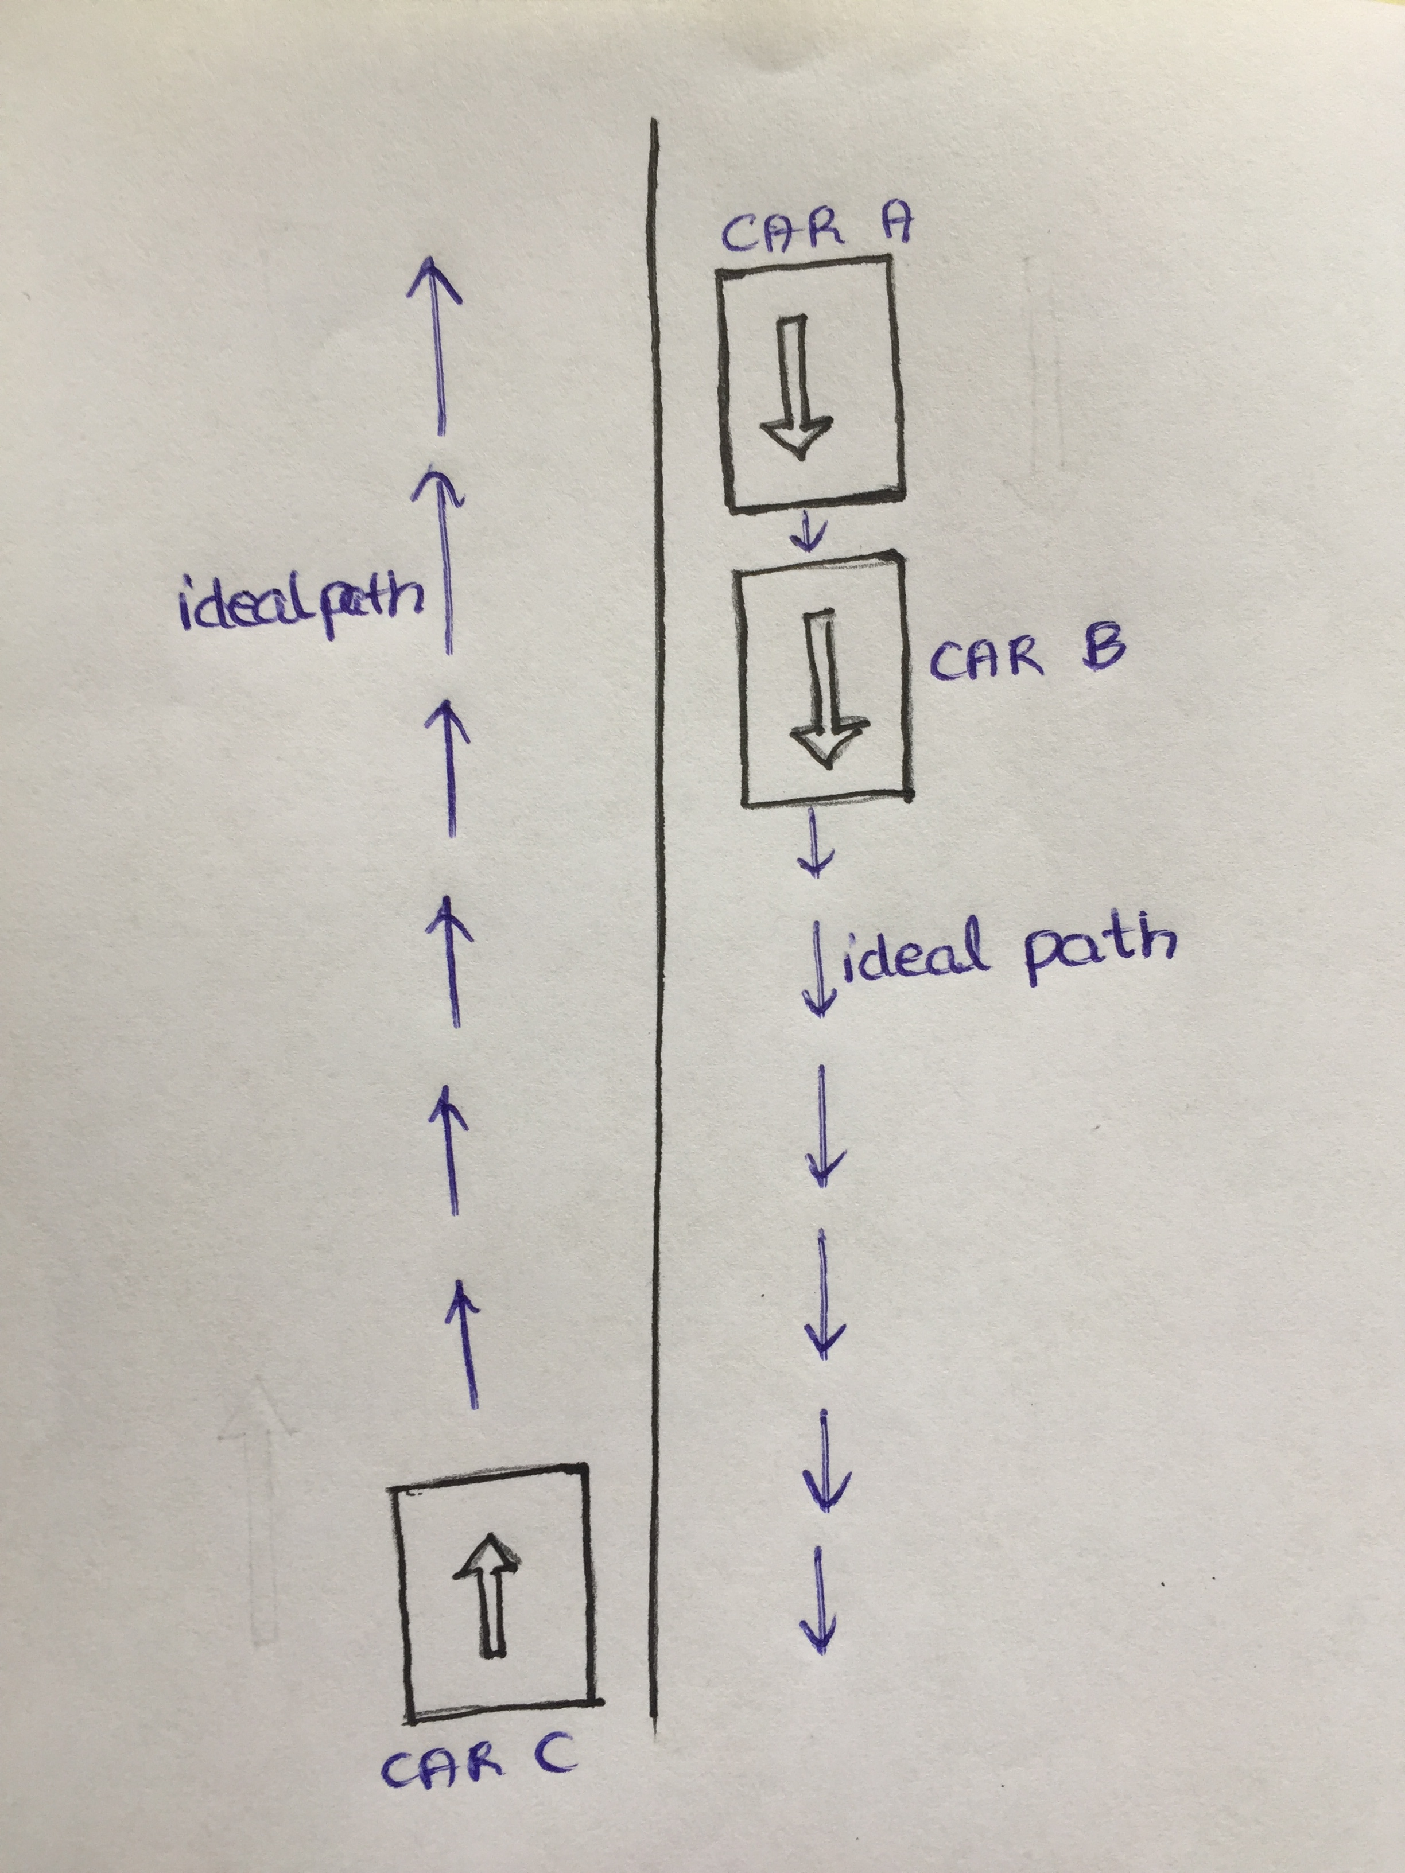
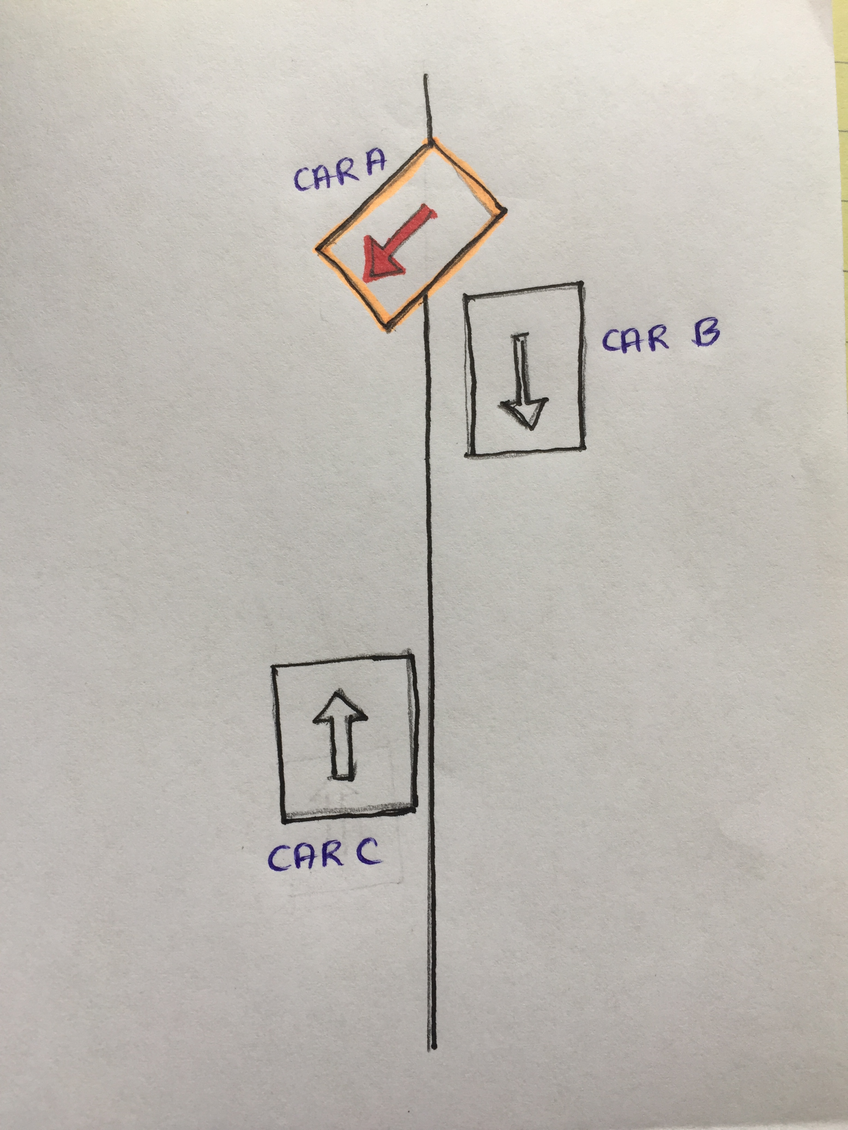
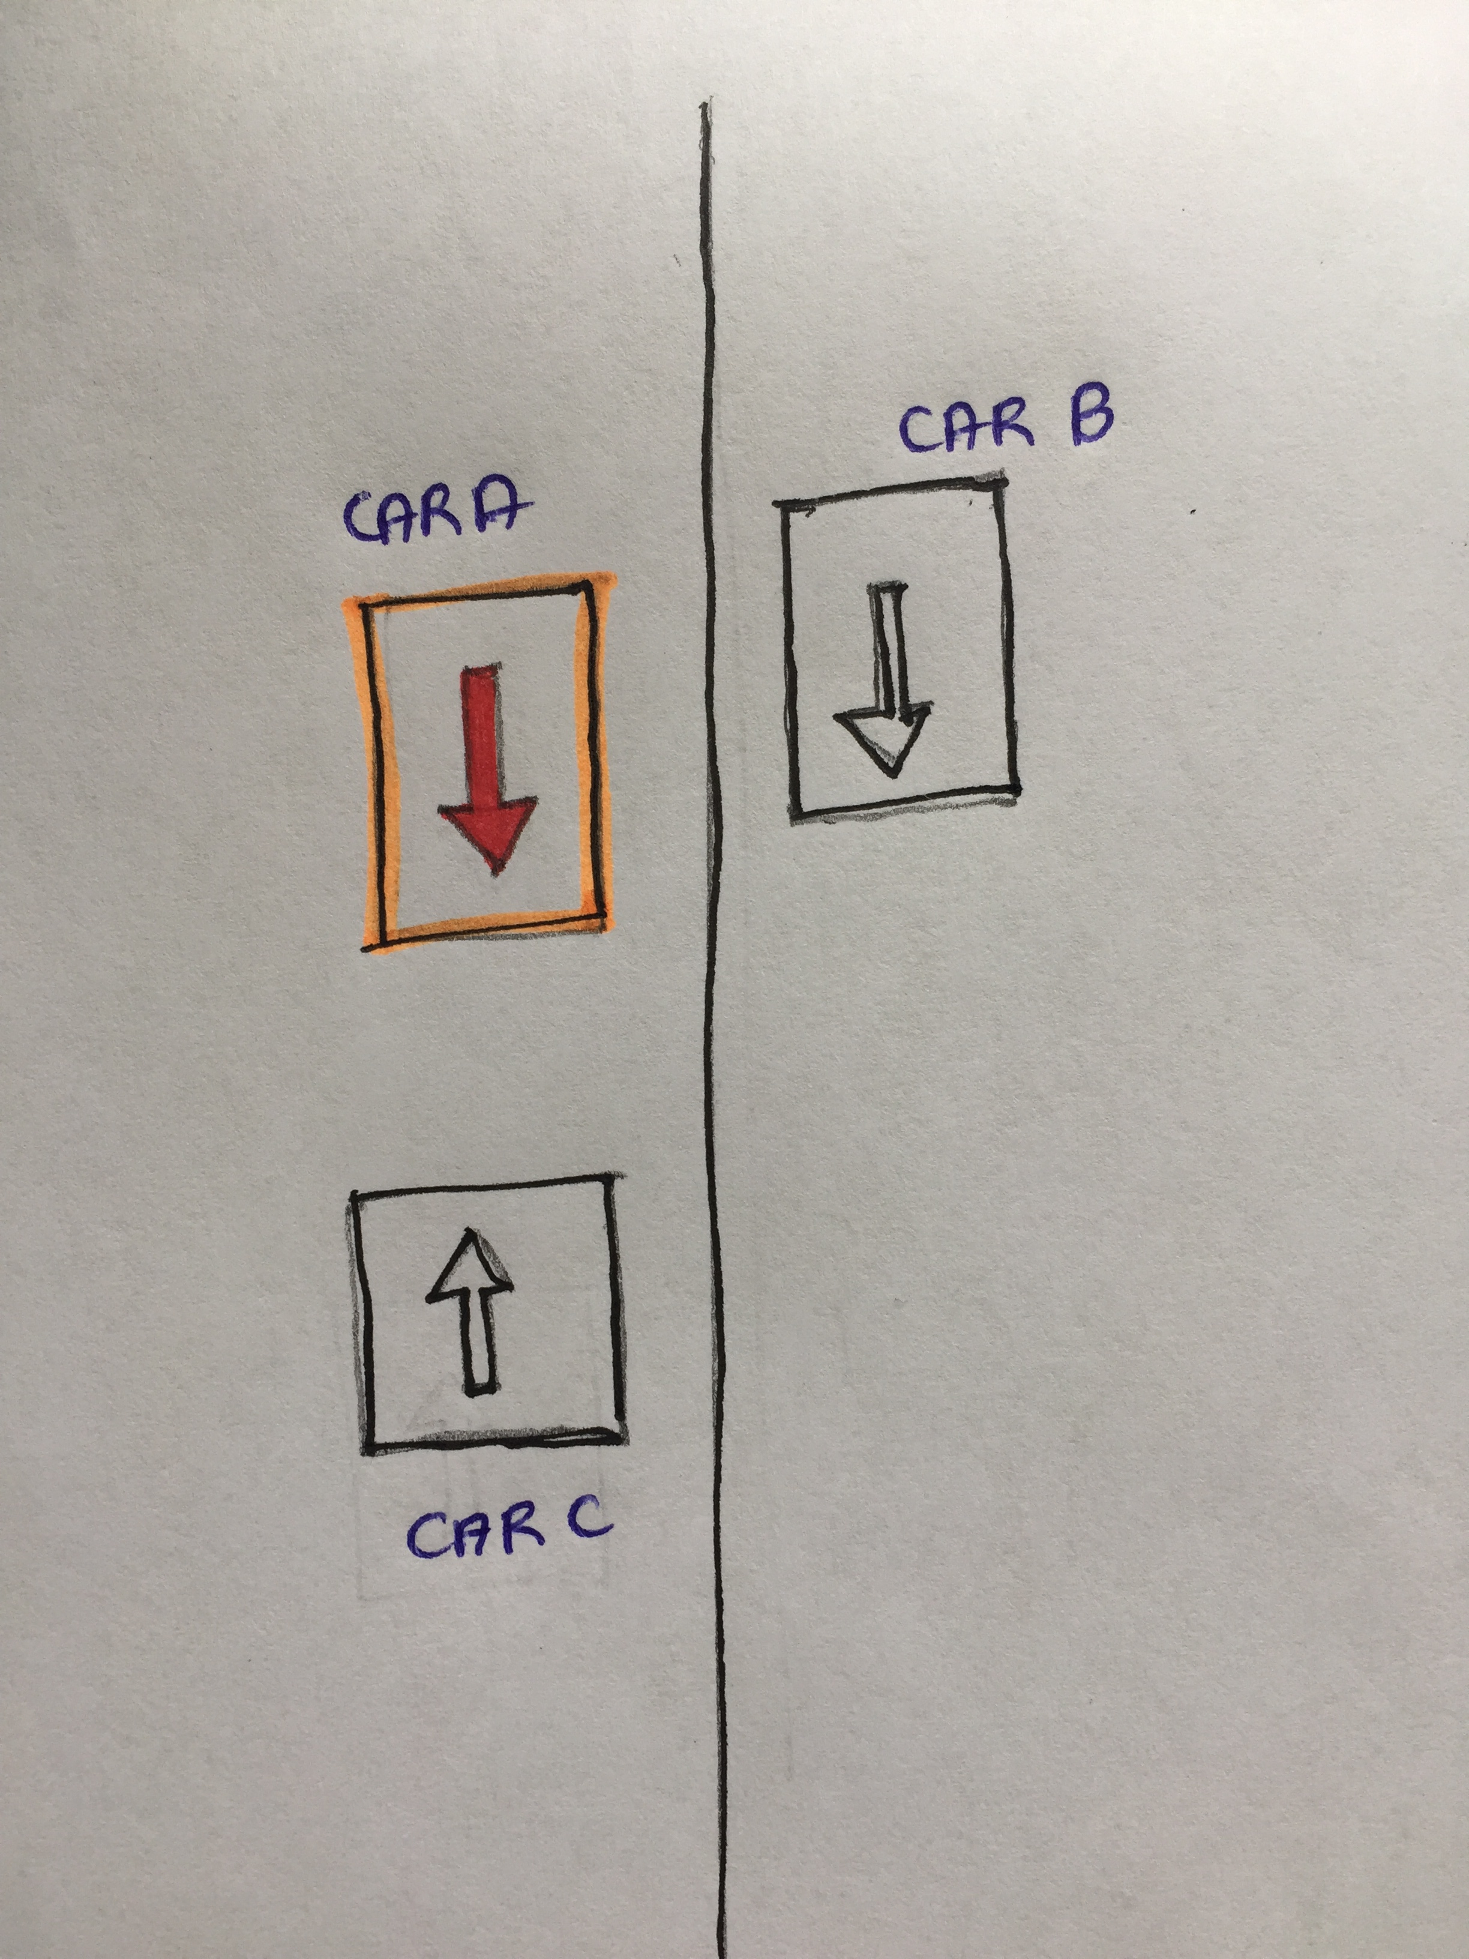
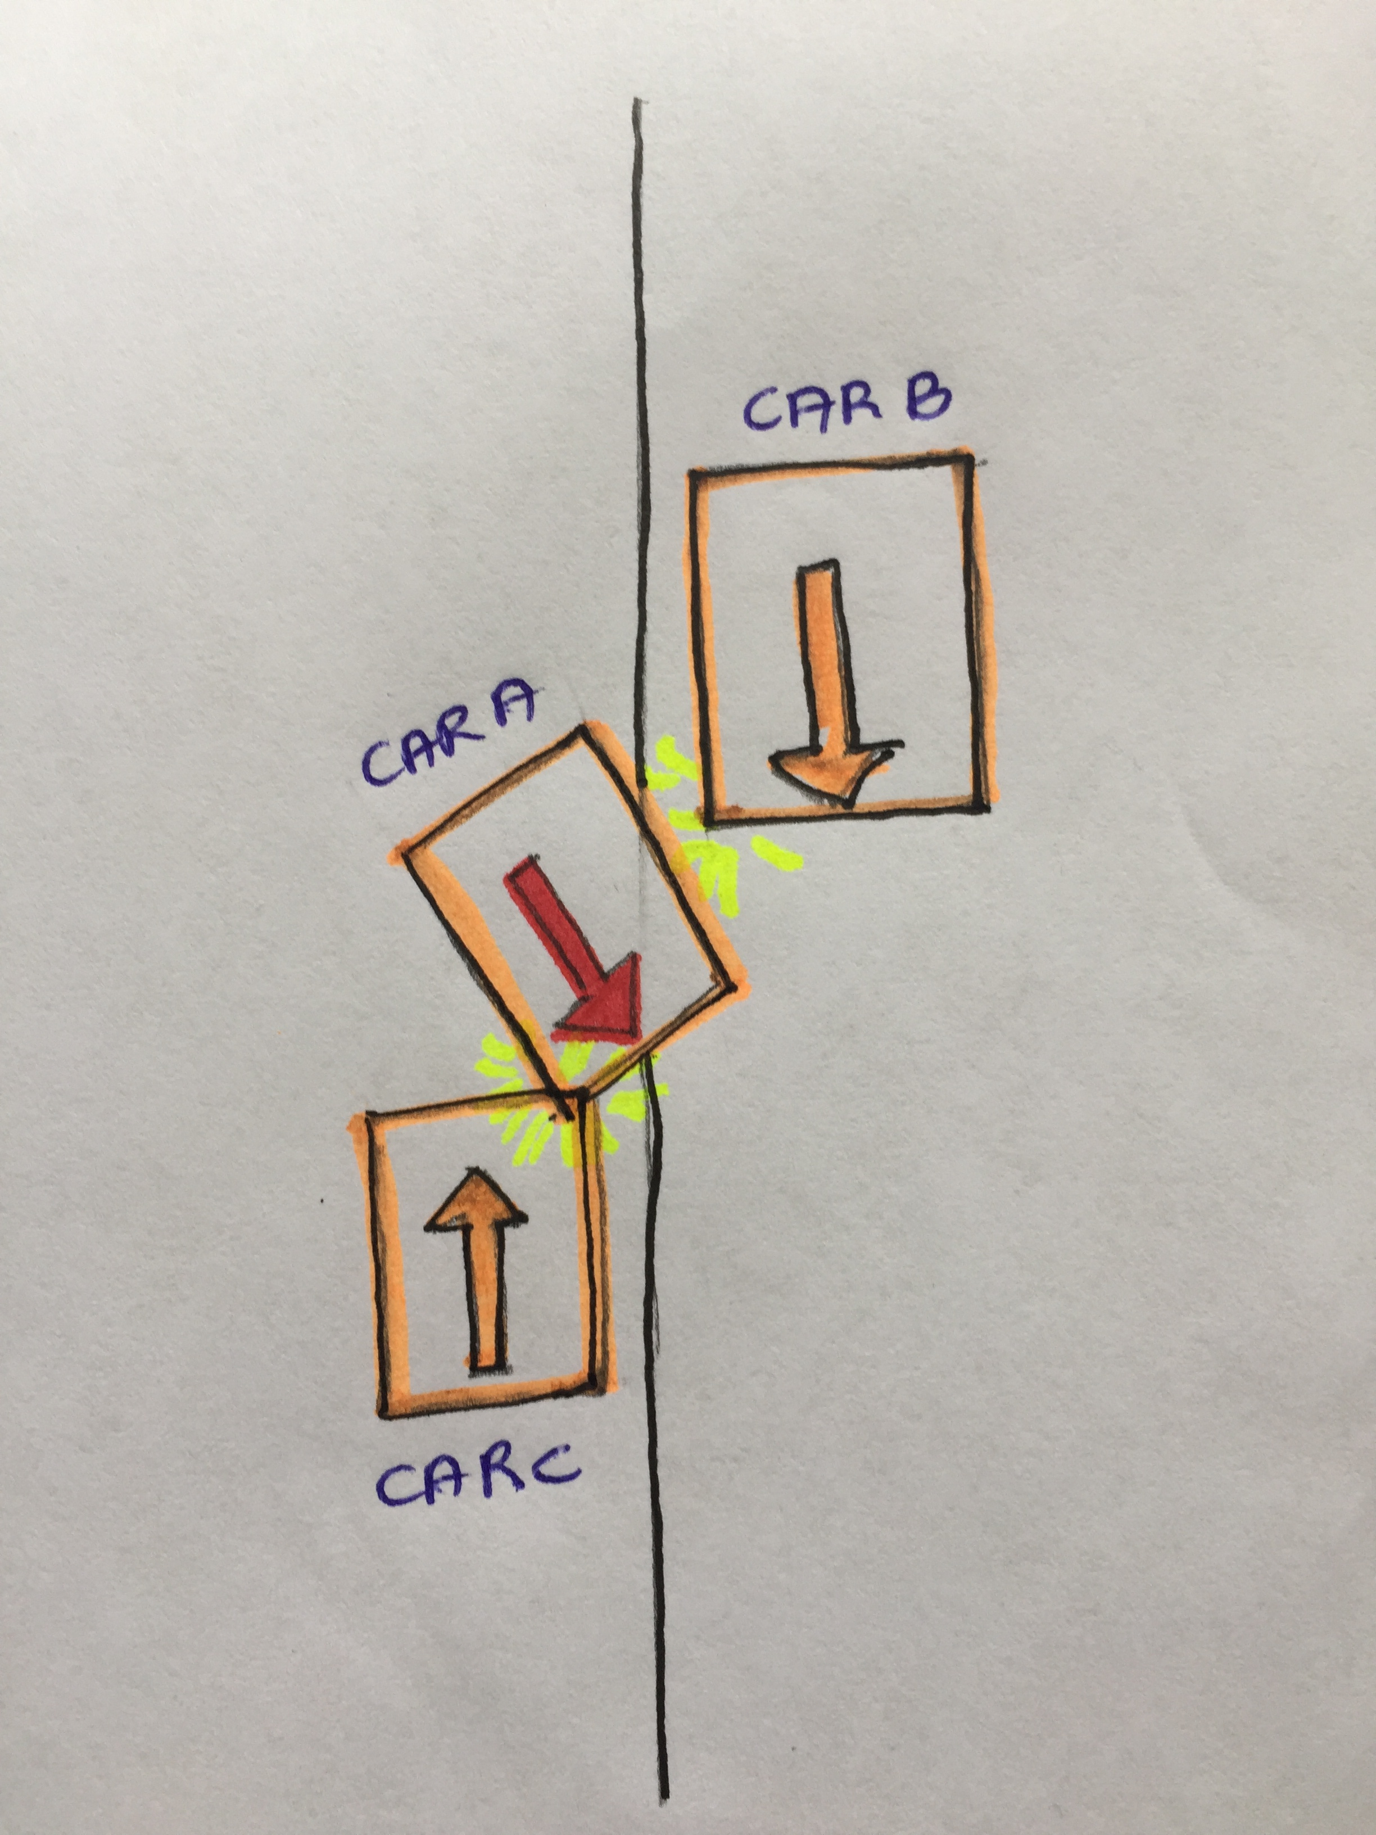
PROBLEM SCENARIO 1 (Overtaking)
Figure 1 (Ideal Case)
Figure 2
Figure 3
Figure 4 (Accident)
Notes:
Especially in the night

Slide 5
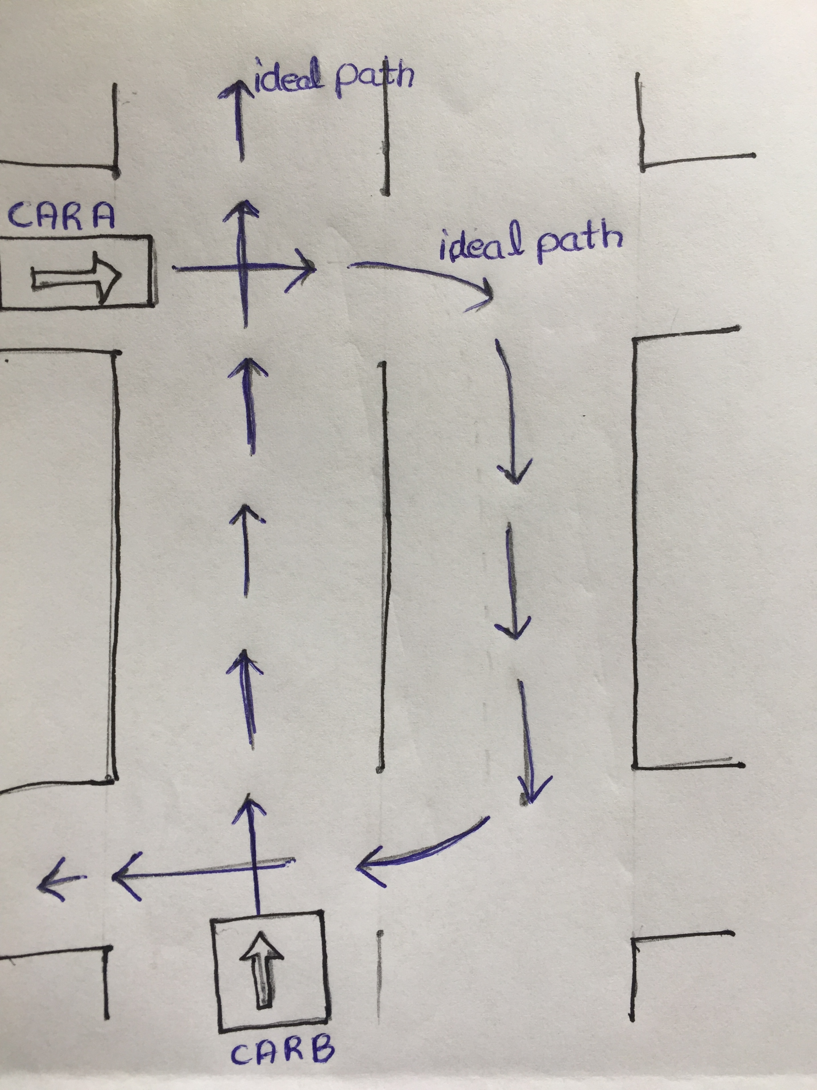
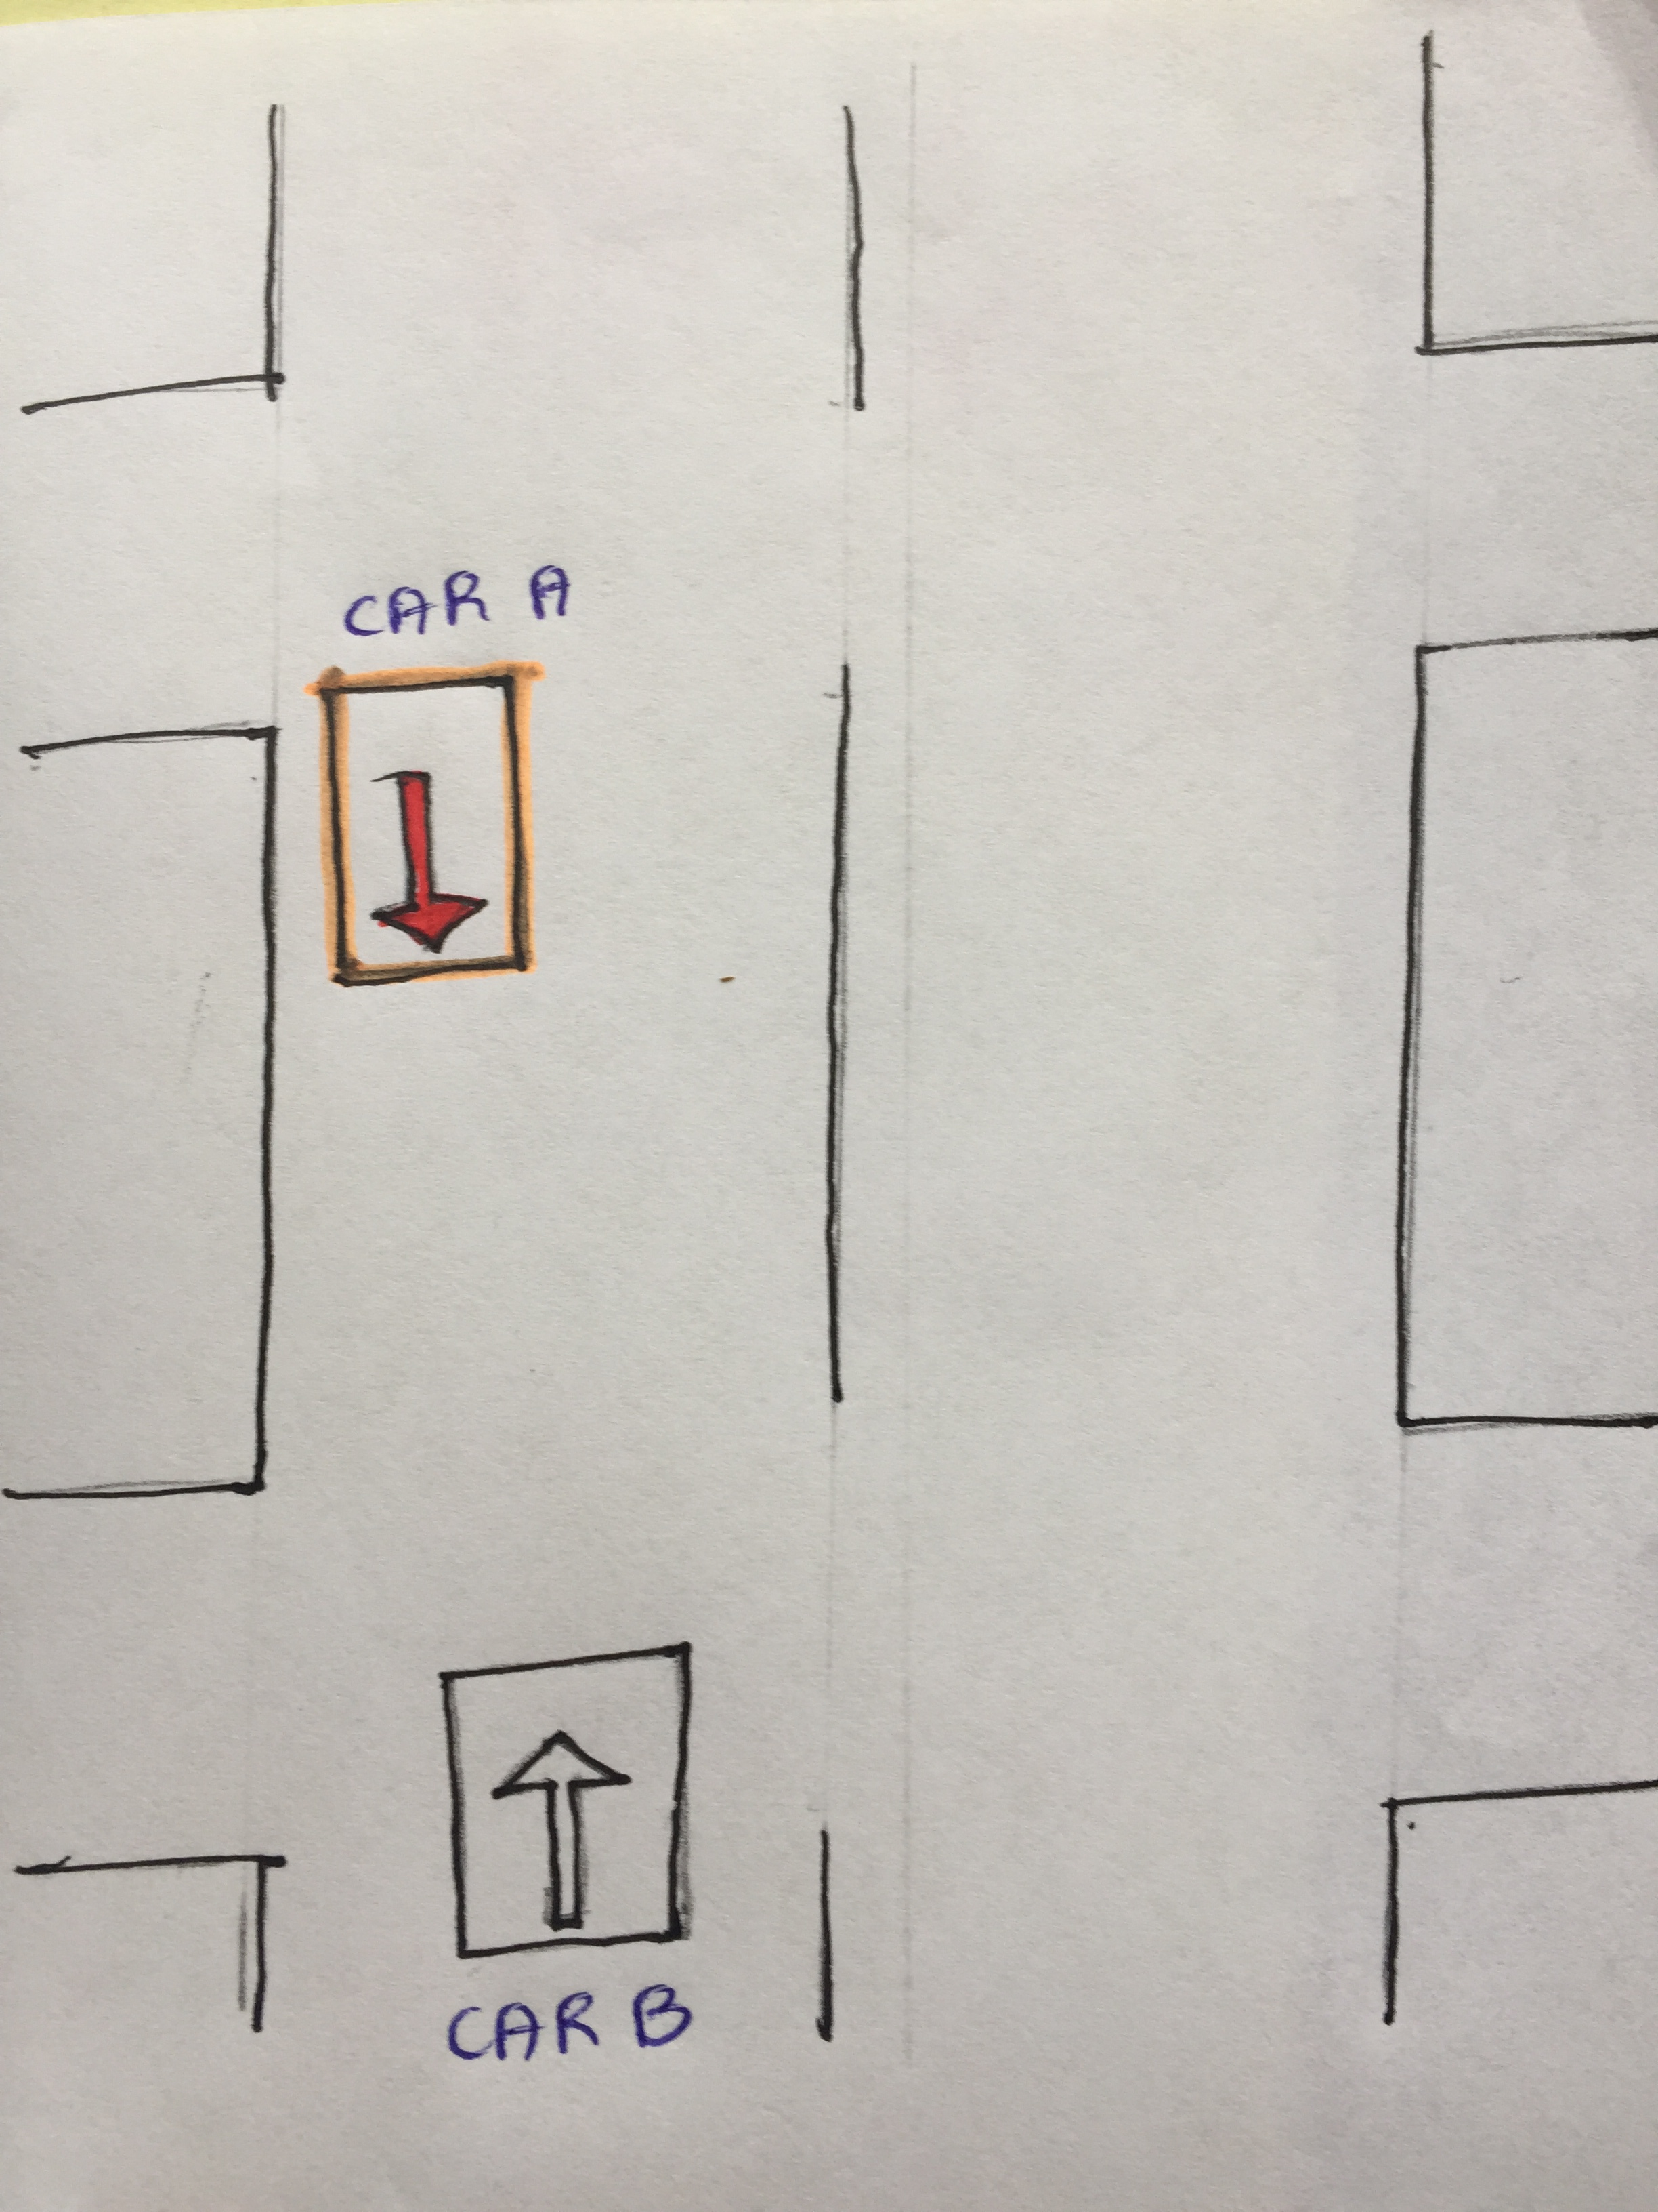
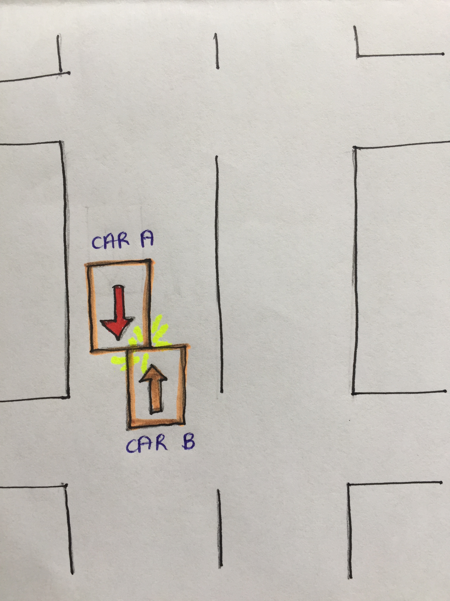
PROBLEM SCENARIO 2 (Lazy/Reckless Driving)
Figure 1 (Ideal Path)
Figure 2
Figure 3 (Accident)

Slide 6
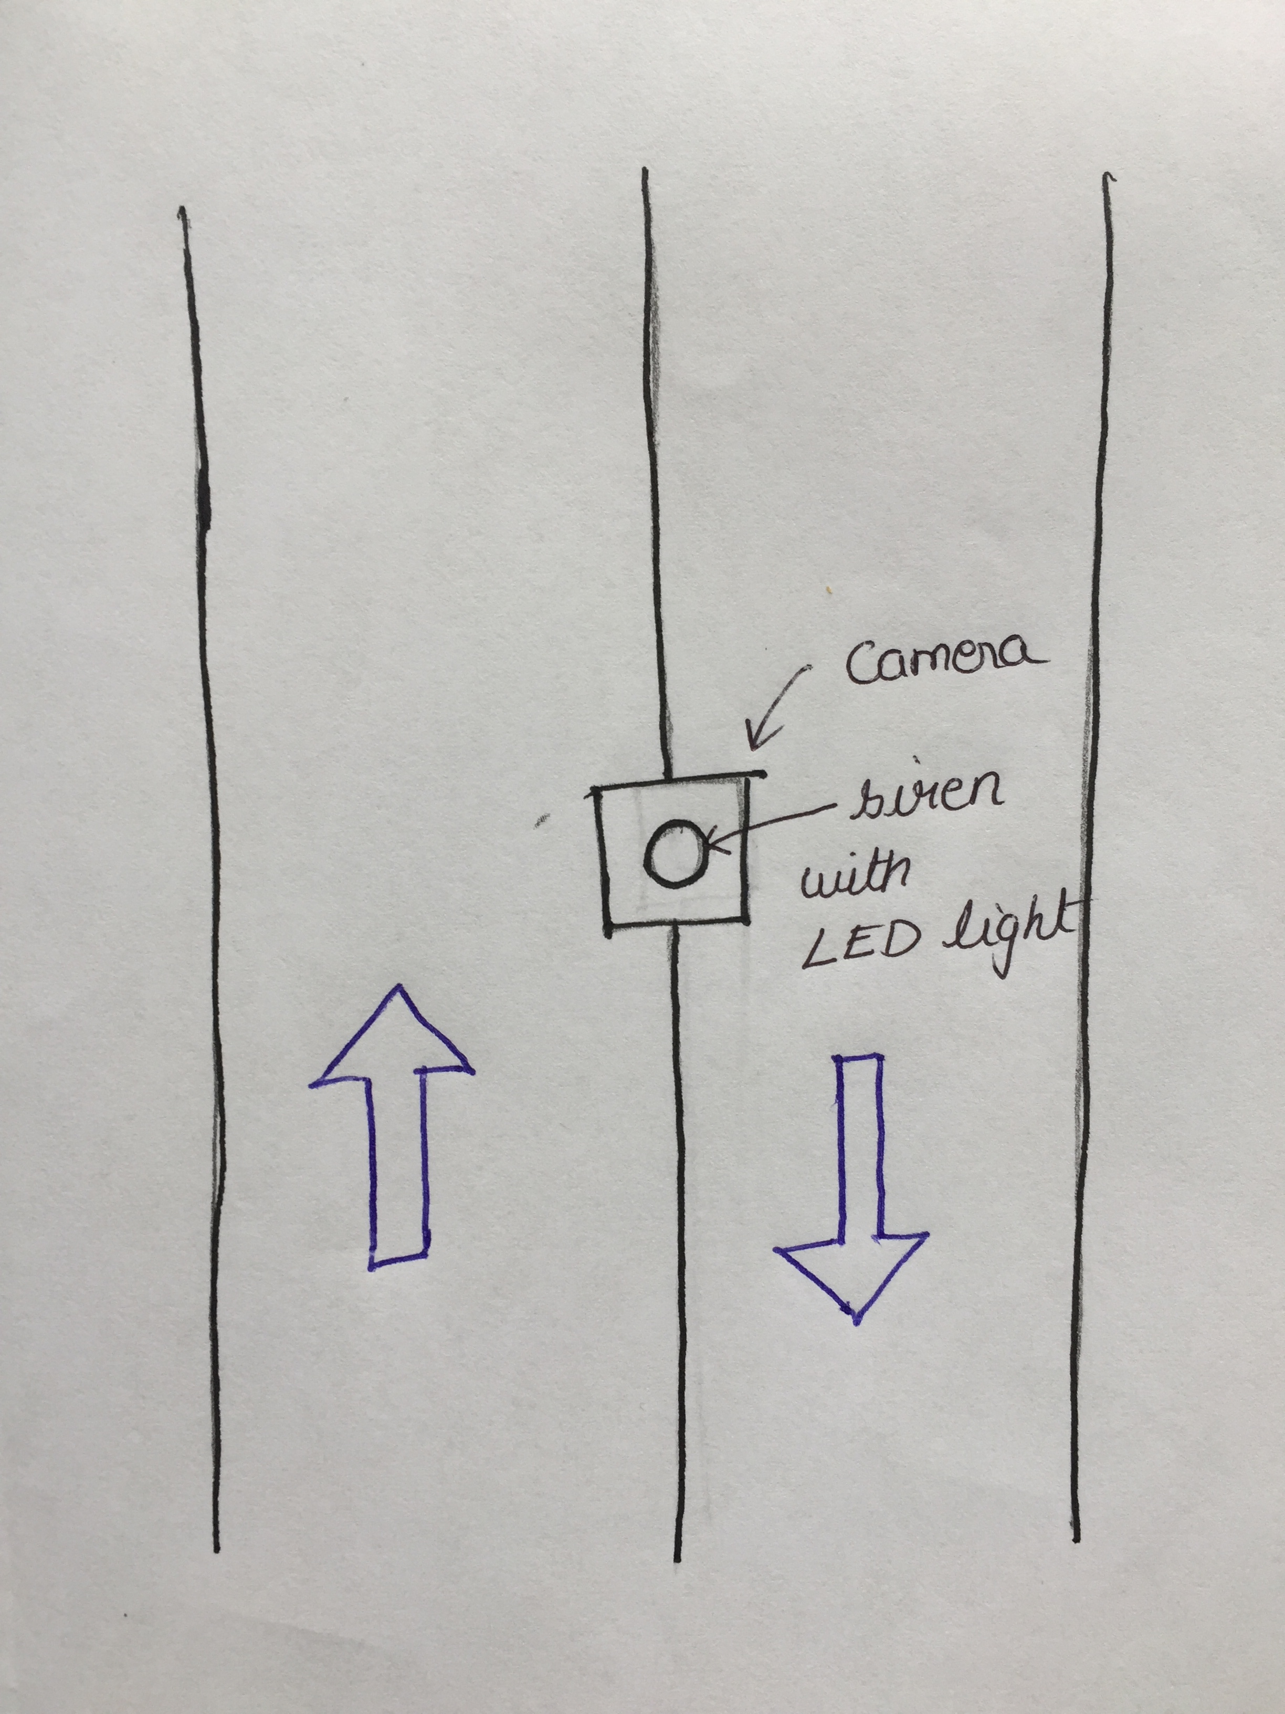
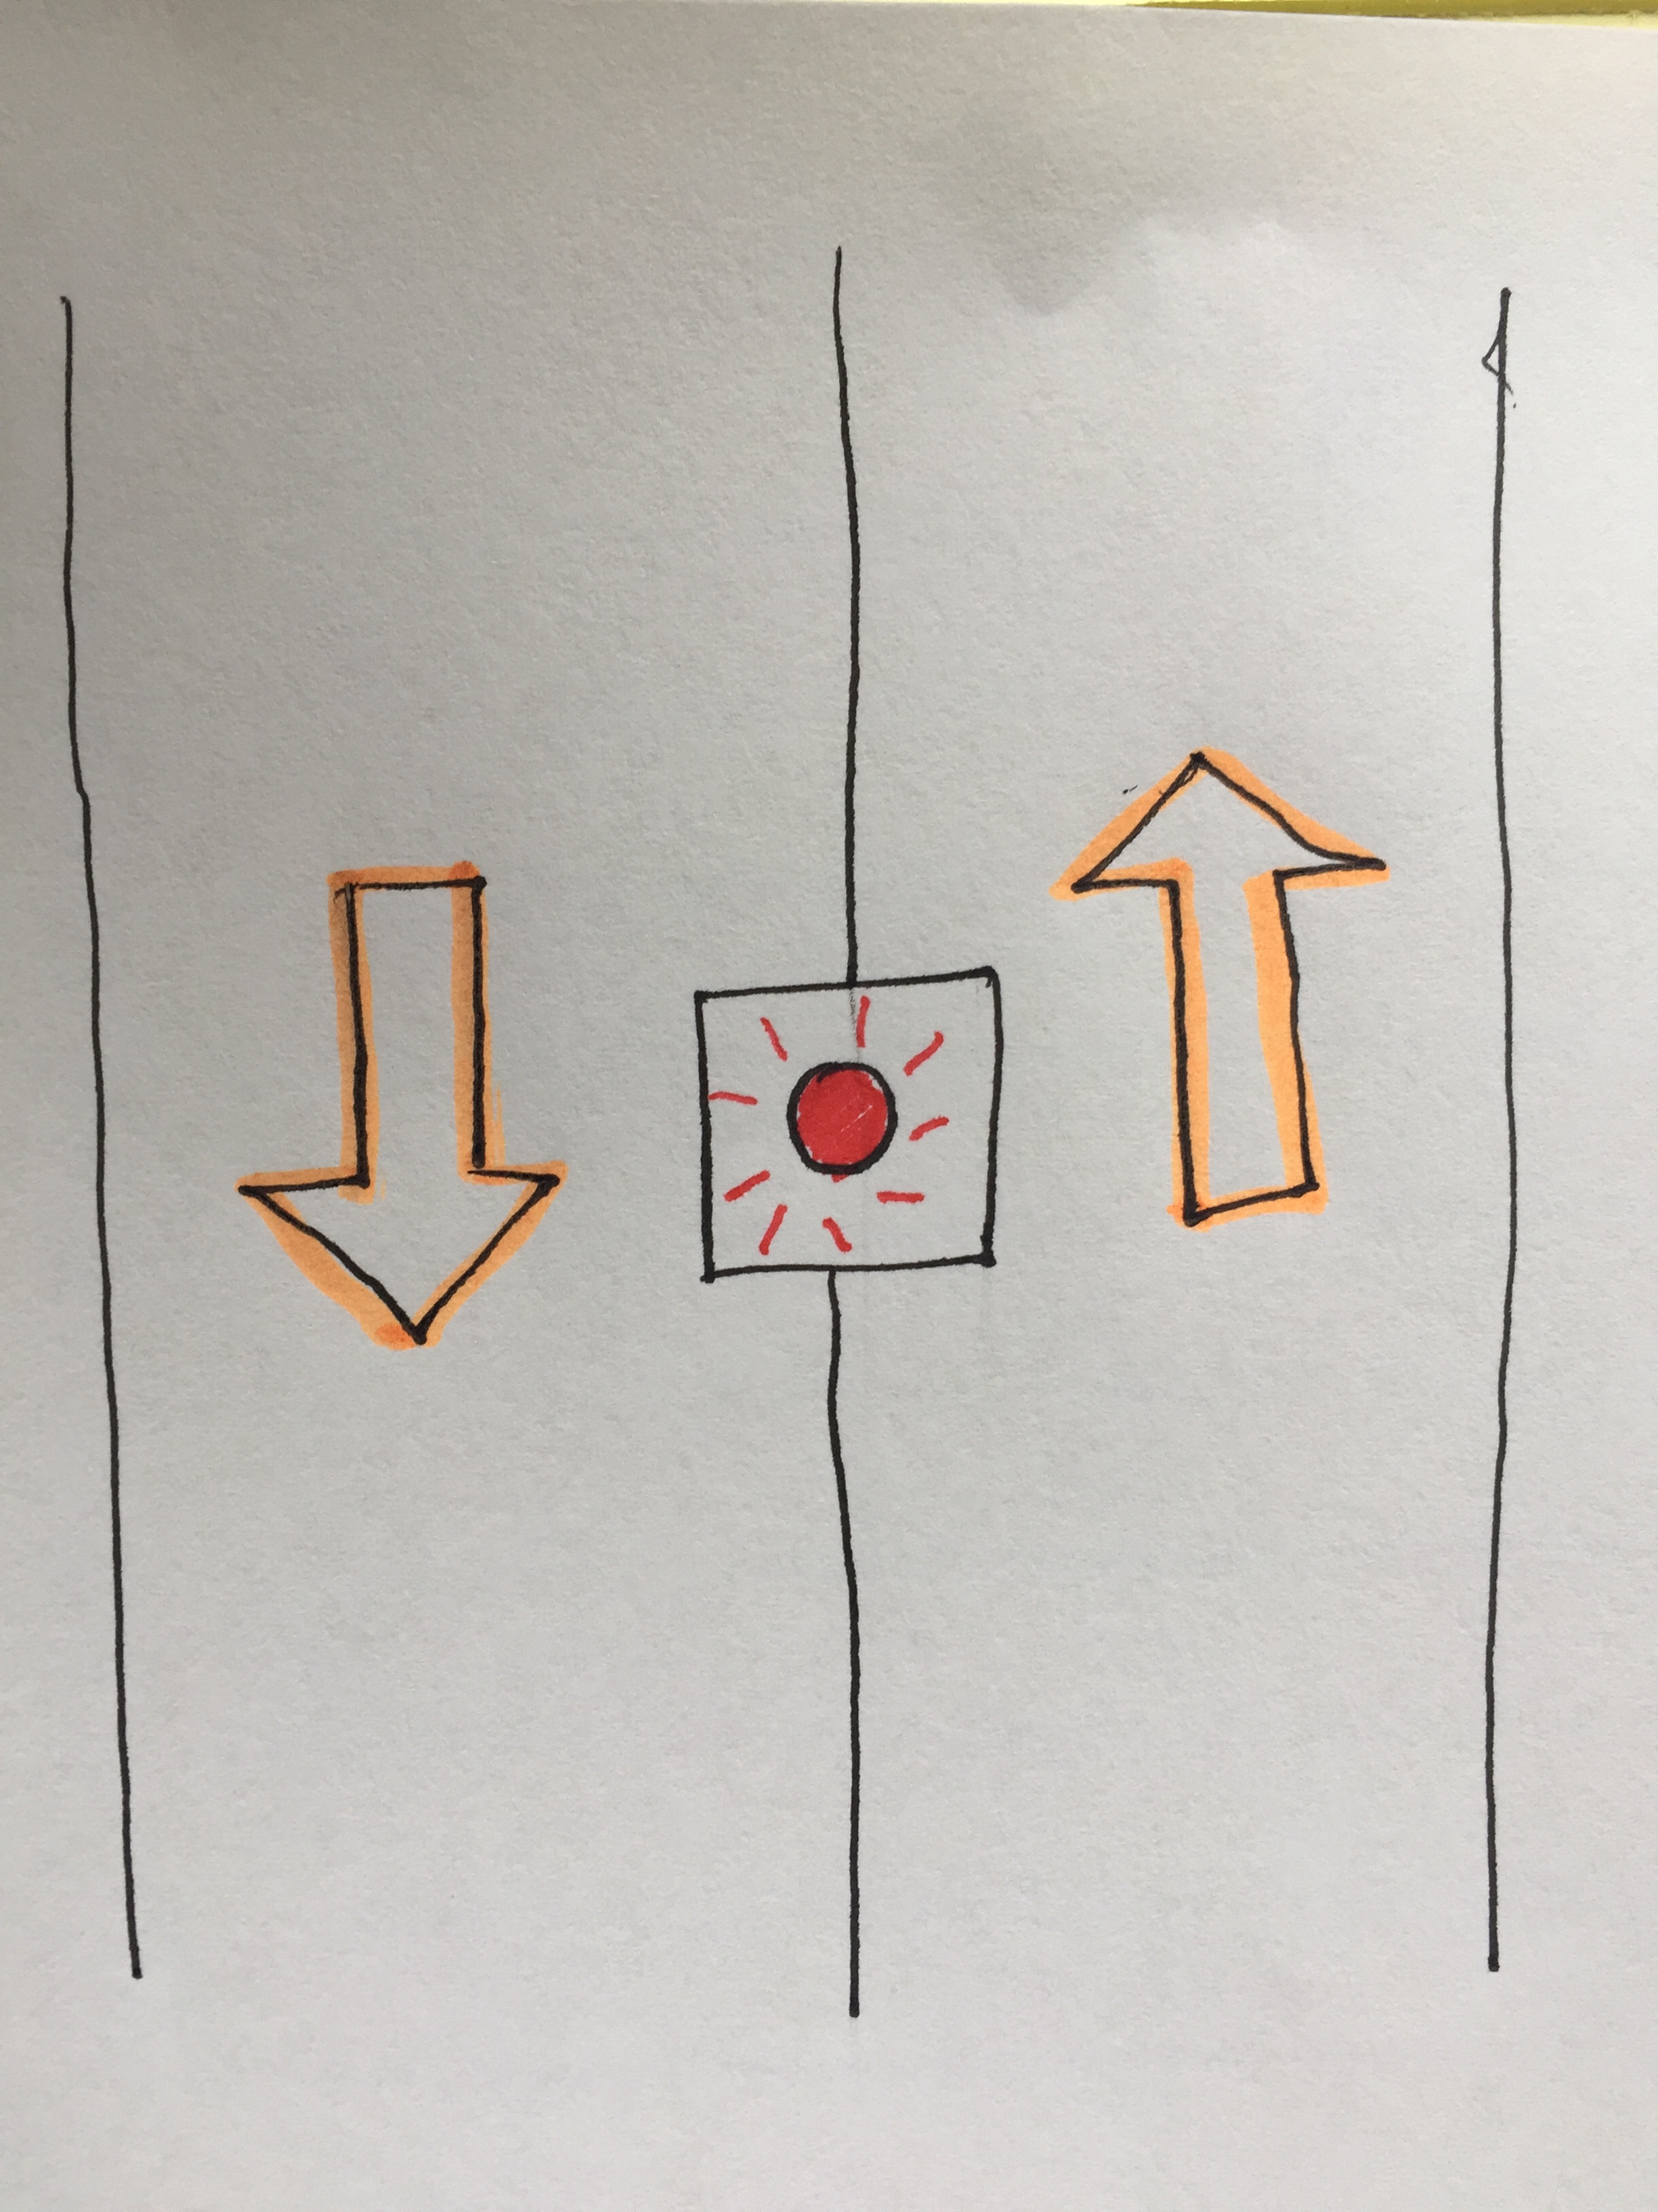
SOLUTION
Vehicles moving in correct directions
No Siren & No LED Light
Vehicles moving in wrong directions
Siren rings & Red LED Light Glows

Slide 7
SOLUTION MODEL
FIRST BLOCK:
Intelligence to detect whether there is any vehicle driving in wrong direction using Computer Vision.
SECOND BLOCK:
Constructing a simple device to utilize the output generated from the first block and ring the siren and glow the red LED light appropriately.
Note: In this project, we will only concentrate on the ‘FIRST BLOCK’

Slide 8
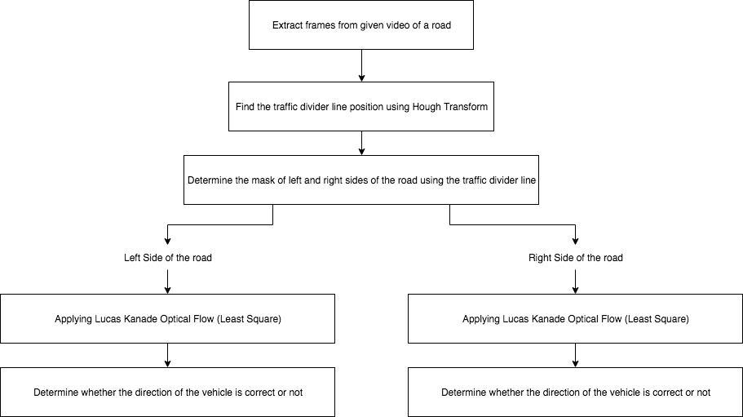
OUTLINE OF THIS PROJECT

Slide 9
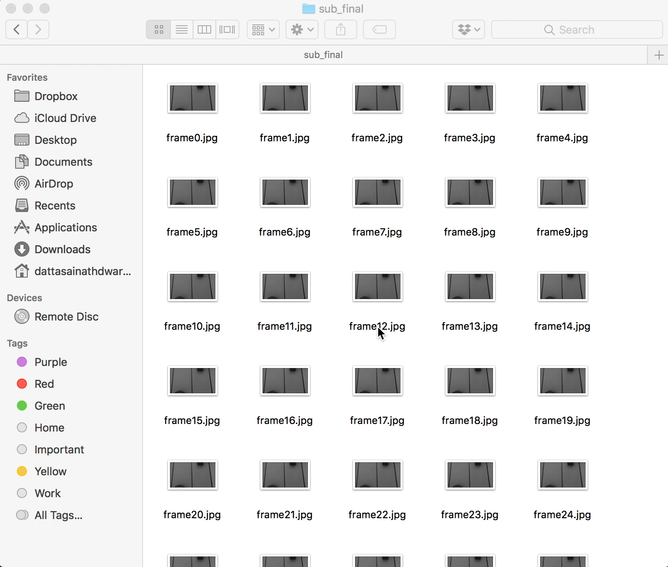
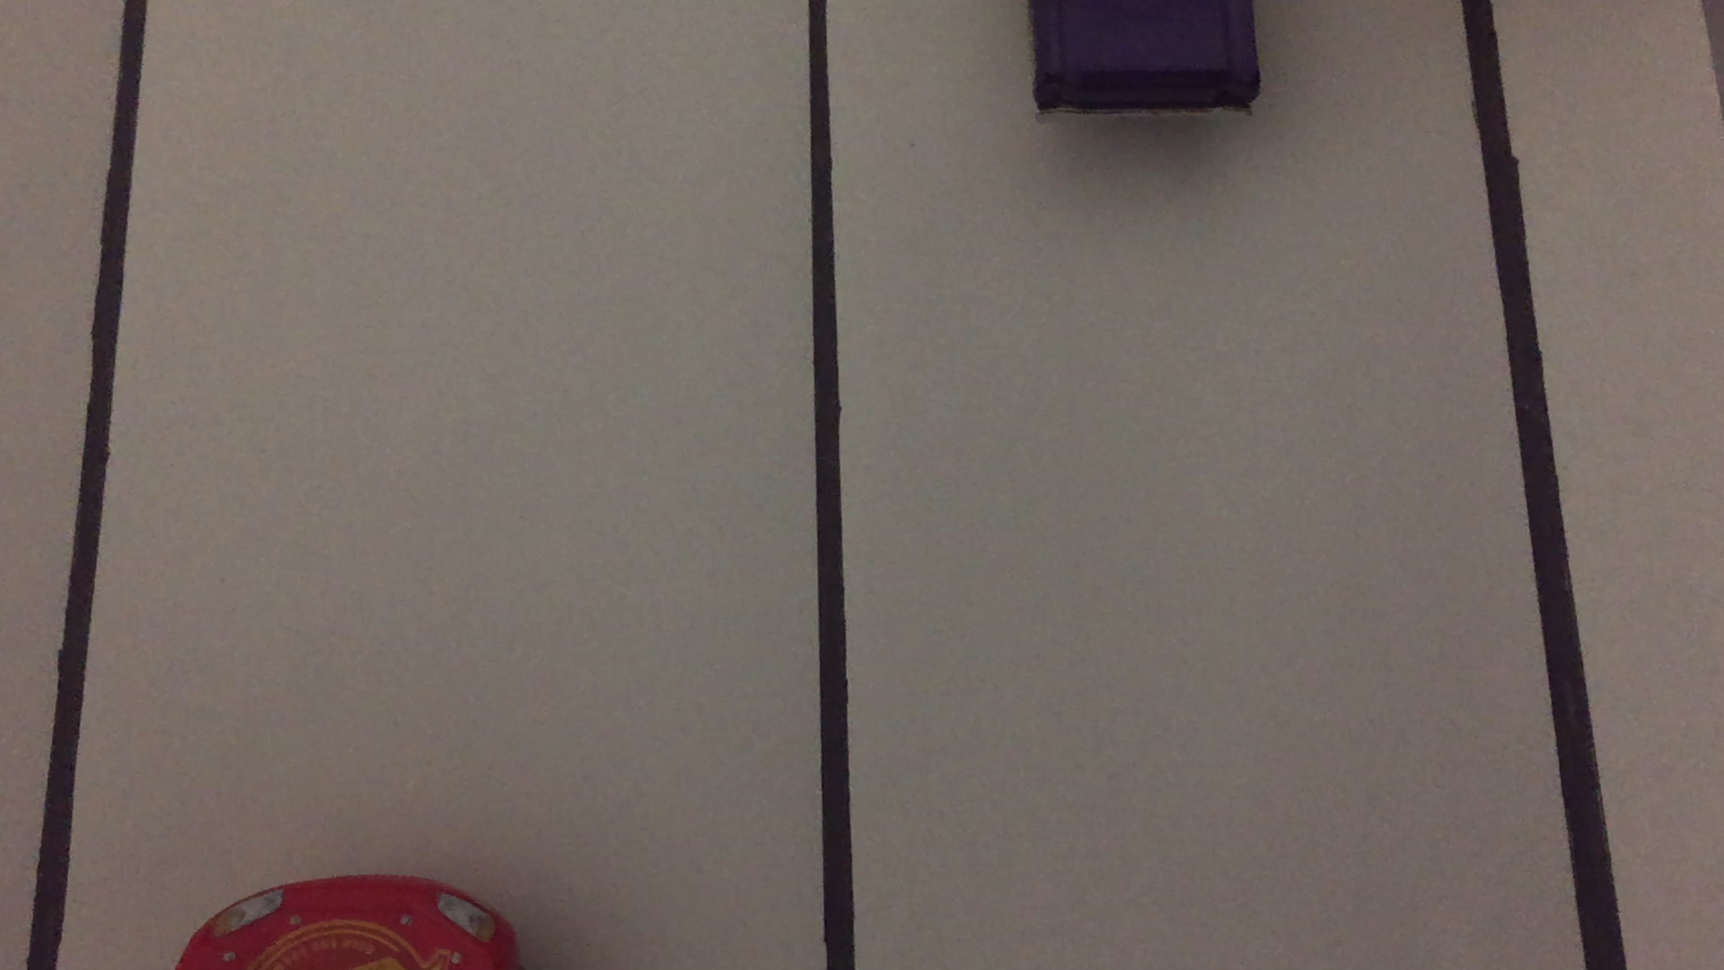
STEP 1: Extract frames from a given video of a road
Note: Used OpenCV package only for this step. For the rest of the steps, I wrote own custom code for each operation.

Slide 10
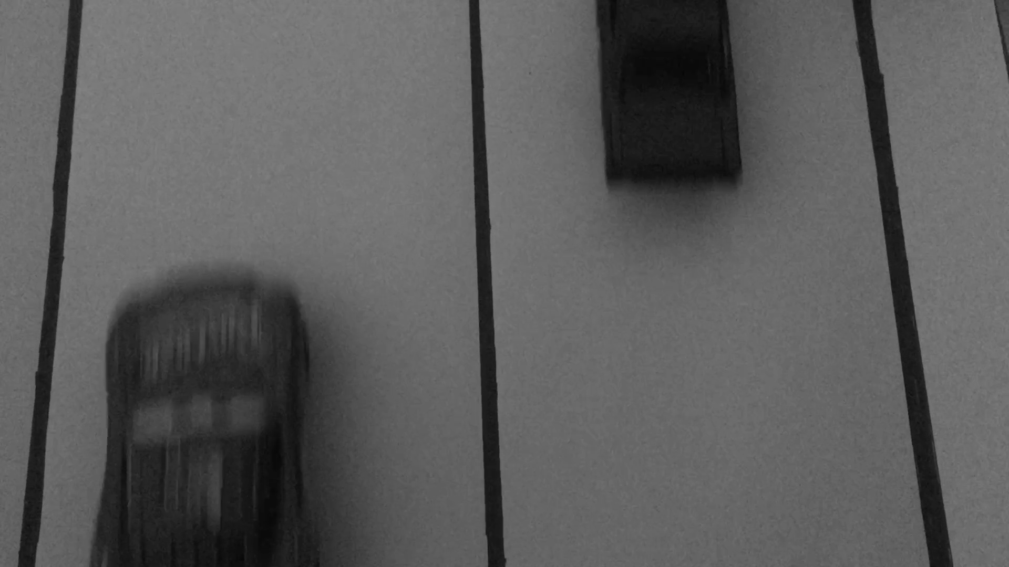

STEP 2: Find the traffic divider line position using Hough Transform
Desired output determining the position of traffic divider

Slide 11
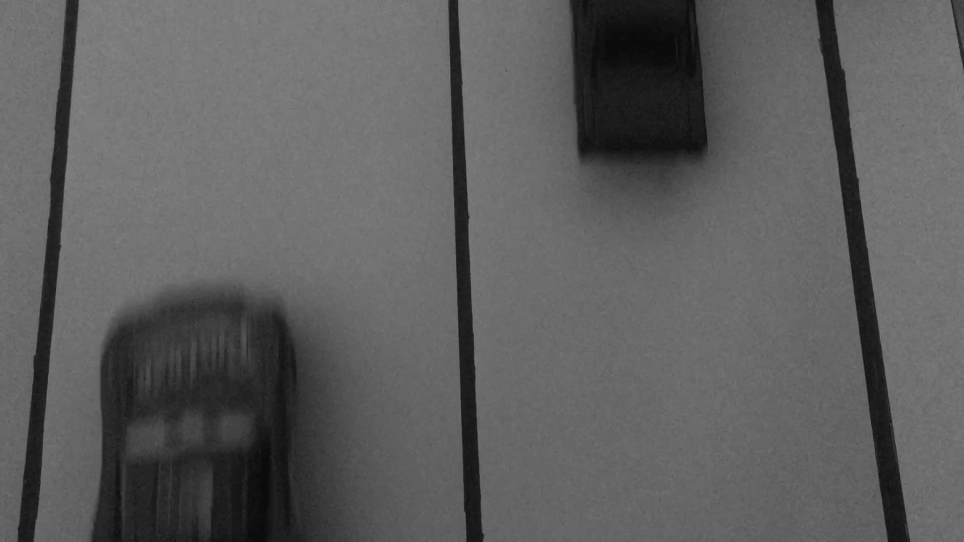
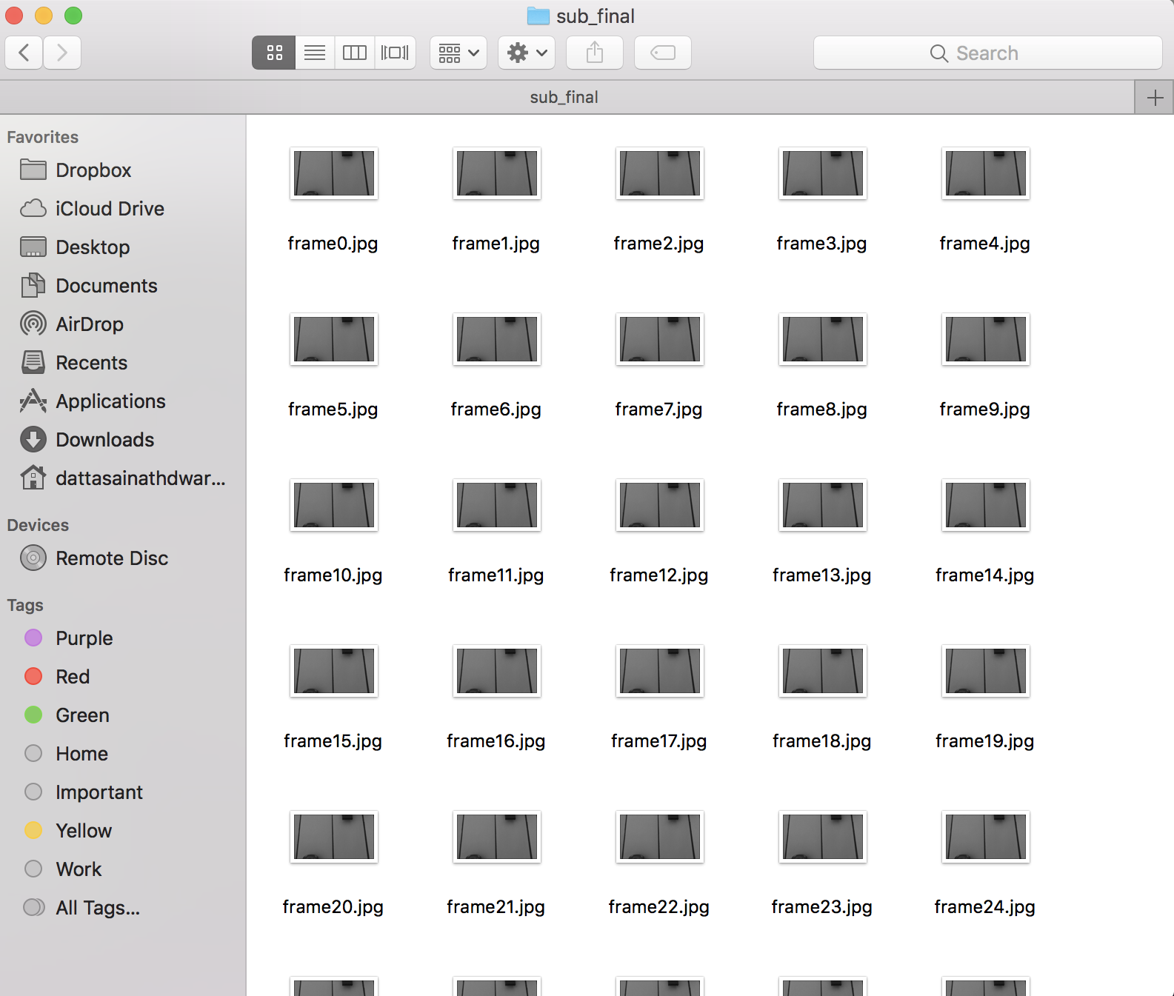
STEP 2(a): Choosing 2 frames for analysis from all the extracted frames.
Frame 1
Frame 2
Explanation: I have always chosen the 65th and 66th percent of all the total frames because most of the action
happened during those frames (cars were visible within that frame).
Suggest approach for real time: Take the photo of an empty road and correlate every real time frame with the
empty road image. The frames which has the least correlation can be used for the analysis.

Slide 12


STEP 2(b): Resizing the frames from 1080 X 1920 to 200 X 400 size
Frame 1
Frame 1
Frame 2
Frame 2
WHY?
Computation time for Hough transform will be low
By reducing the resolution of 2 frames, the motion between the two frames will be less. So
Lucas Kanade method can be applied as Lucas Kanade will work for small displacements only

Slide 13
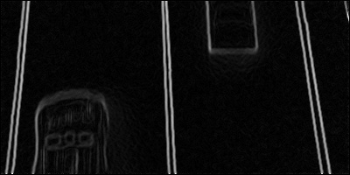
STEP 2(c): Preparing the image for the Hough Transform
Smoothing the image using a K X K Smoothing Filter
Performing Edge Detection
And thresholding
Smoothed, Edge Detected and Thresholded Output
Explanation: To do an Hough transform we should know the lines or edges which exists on an image.
To get a good smooth edge (removing or smoothing sharp noise) we do smoothing before finding the edges.
Edge detection was performed by finding the x and y gradient of an image.
I thresholded after edge detection to remove unnecessary small edge like the edges on a car or a road which is
not useful for Hough transform.

Slide 14
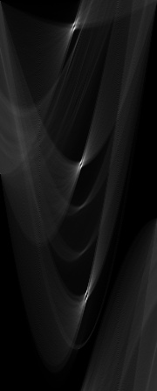
STEP 2(d): Performing Hough Transform on the edge detected image
Explanation:
I have added the pixel value/255 to the Hough space rather
than adding 1. Since we can see that the divider was carrying
the maximum intensity.
We can clearly see 3 bright spots in the accumulator.
3 spots represent one road divider in the middle of the road
and two margin lines on either side of the road.
Extension: I tried using the orientation of edges and optimizing the
Hough Transform but I could get good results only when the
Road divider line was clearly visible, if the image had lots of
noise, it was tough to detect the divider.
Hough Space
(Accumulator)

Slide 15
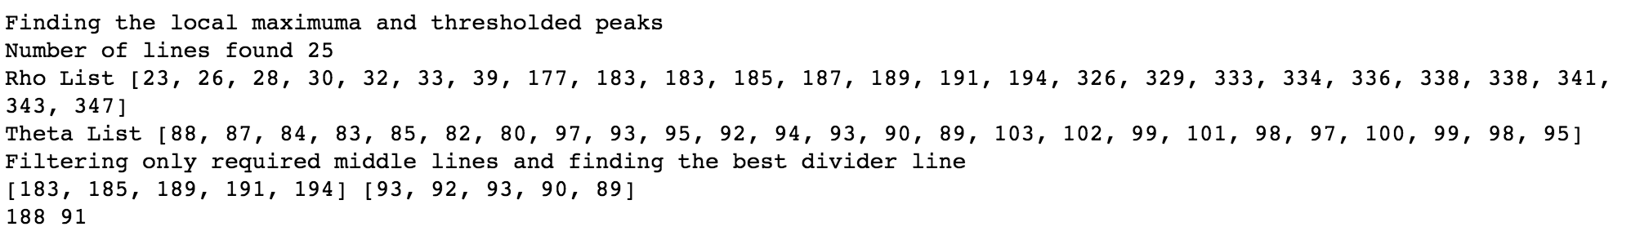
STEP 2(e): Detection of the divider line from the accumulator produced by Hough transform
Applied Local Maxima Detection and Thresholding of Peaks found
Applied a detector which detects lines which are nearer to the middle of the frame and have an angle 90 ± 5
Applying mean of the parameters for the points detected to determine a single line
Traffic Divider Line Image

Slide 16


STEP 3(a): Determine the masks of left and right sides of the road using the traffic divider line
Right Mask
Left Mask
Traffic Divider Line Image
Explanation: We can easily generate the left and right masks from the divider line by highlighting the
the left and right portions of divider line appropriately which can be later used for optical flow process

Slide 17
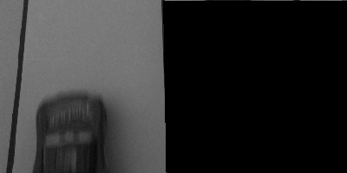
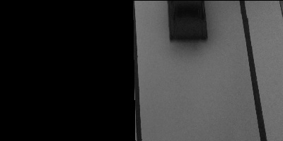
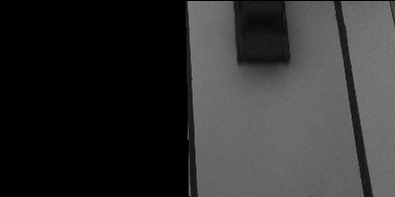
STEP 3(b): Applying Masks to both the frames
Left Mask
Right Mask
Left Image of Frame 1
Left Image of Frame 2
Right Image of Frame 1
Right Image of Frame 2
Explanation: By multiplying the masks with the frames we can get 4 different images with 2 images each for
analyzing each side of the road

Slide 18
STEP 4: Optical Flow on Right and Left sides of the road

Slide 19

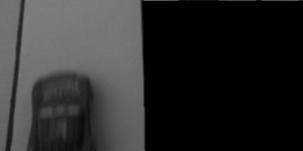
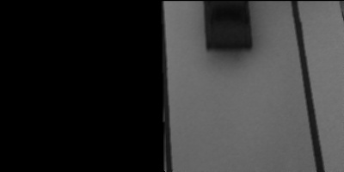

STEP 4(a): Gaussian Smoothing on the images before applying optical flow method
Left Image of Frame 1
Left Image of Frame 2
Right Image of Frame 1
Right Image of Frame 2
Gaussian Smoothing
Gaussian Smoothing
Gaussian Smoothing
Gaussian Smoothing
Smoothed
Left Image of Frame 1
Smoothed
Left Image of Frame 2
Smoothed
Right Image of Frame 1
Smoothed
Right Image of Frame 2
Explanation: I applied gaussian smoothing before finding the x, y and t derivatives on both the frames because
smoothing the images removed any sharp noises and intensities and we get smoothed derivatives finally.

Slide 20
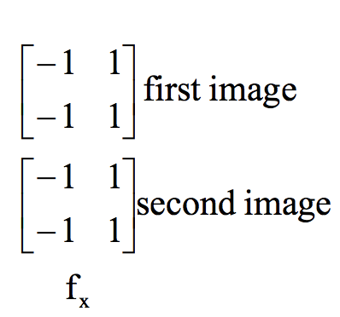
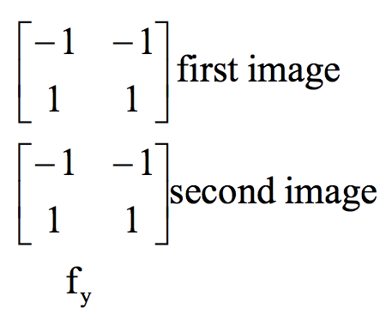
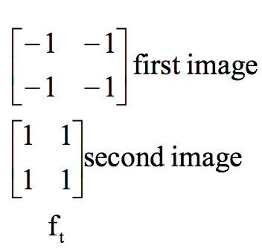
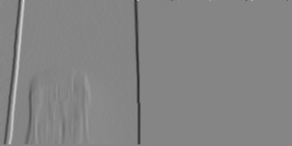
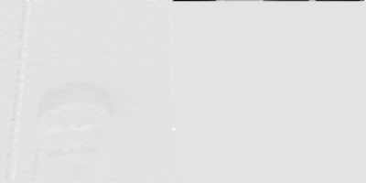
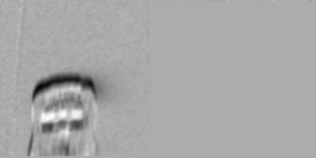
STEP 4(b): Determining x, y and t derivatives for both frame on left side of the road
Gaussian Smoothing
Gaussian Smoothing
Gaussian Smoothing
Averaged x derivative
Averaged y derivative
Averaged t derivative
Explanation: Used Roberts masks to computer x, y and t derivates across 2 frames and also performed gaussian
smoothing on the derivatives to get smoothed optical flow.
Inputting a smoothed image to the optical flow will give a smoothed u and v matrixes which results in smoothed
magnitude and direction matrixes of u and v

Slide 21
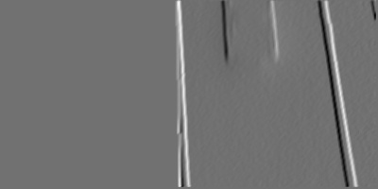
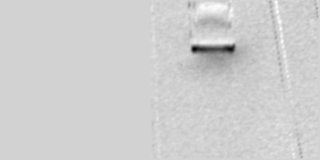
STEP 4(b): Determining x, y and t derivatives for both frame on right side of the road
Gaussian Smoothing
Gaussian Smoothing
Gaussian Smoothing
Averaged x derivative
Averaged y derivative
Averaged t derivative
Explanation: Used Roberts masks to computer x, y and t derivates across 2 frames and also performed gaussian
smoothing on the derivatives to get smoothed optical flow.
Inputting a smoothed image to the optical flow will give a smoothed u and v matrixes which results in smoothed
magnitude and direction matrixes of u and v

Slide 22
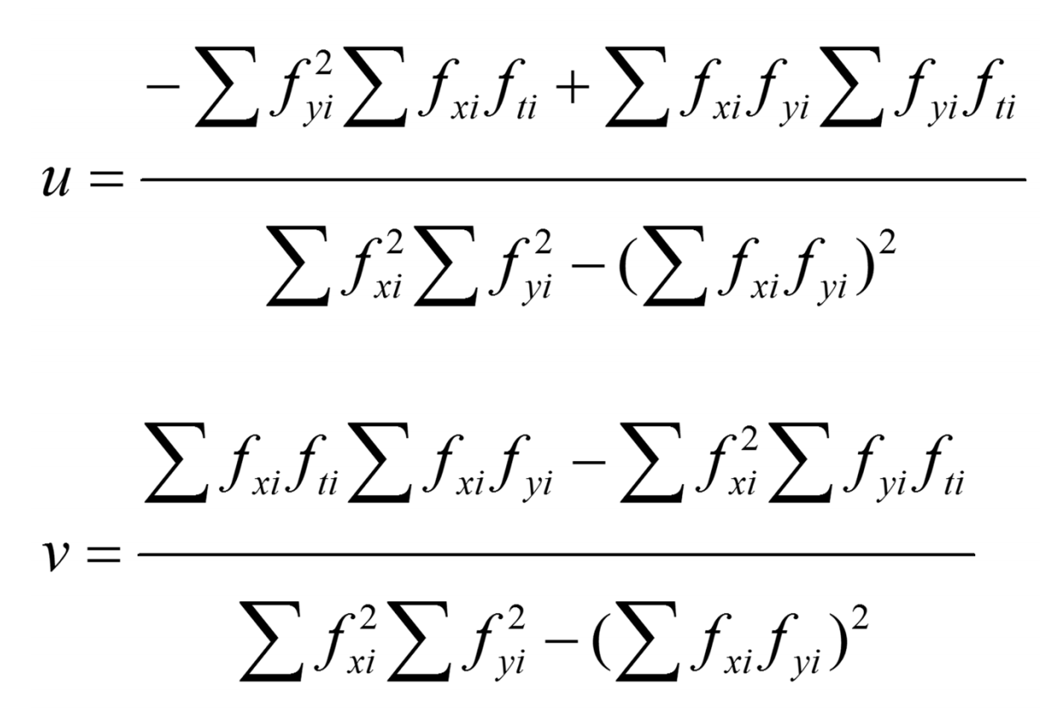
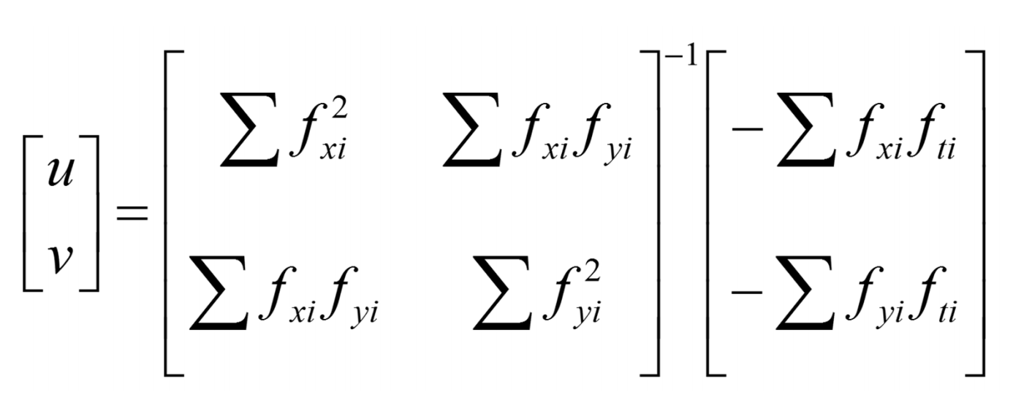
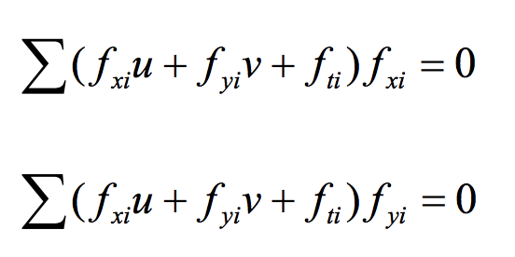
STEP 4(C): Applying Lucas Kanade Method (Least Squares)
Most Important Formula used to calculate u and v

Slide 23
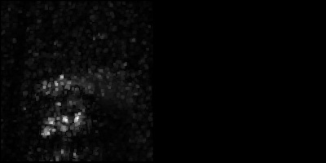
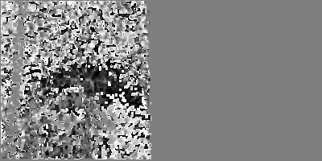
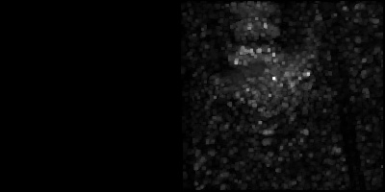
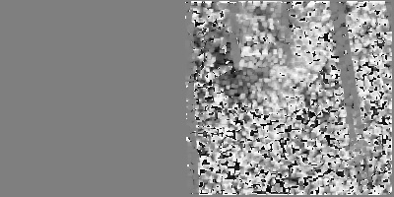
STEP 4(C): Applying Lucas Kanade Method (Least Squares)
Left Side of the road
Right Side of the road
Apply median filter on u and v
Apply median filter on u and v
UV Magnitude
UV Direction
UV Magnitude
UV Direction

Slide 24
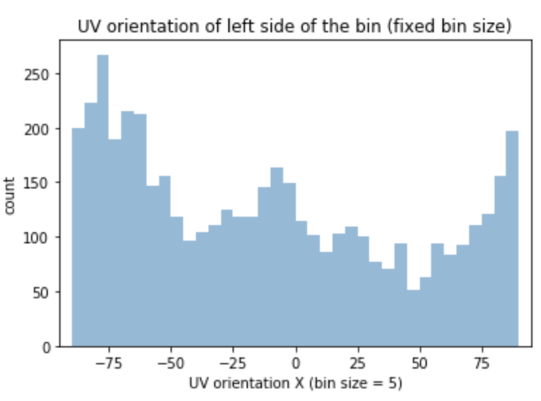
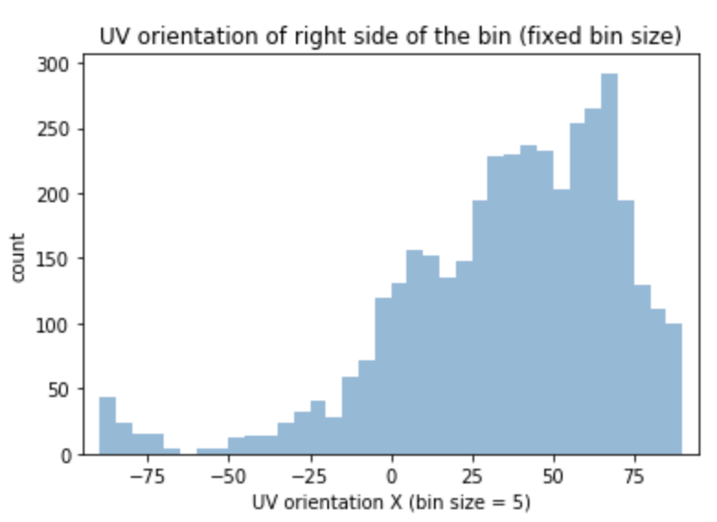
STEP 5: Determine whether the direction of the vehicle is correct or not
Left Side of the Road
Right Side of the Road
Plotting the directions of the pixels which ever has a UV magnitude value greater than a threshold value
Plotting the directions of the pixels which ever has a UV magnitude value greater than a threshold value
Choose the degree with maximum count
Choose the degree with maximum count
If maximum degree less than 0
If maximum degree more than 0
Yes
No
Yes
No
Vehicle is in the right direction
Vehicle is in the wrong direction
Vehicle is in the right direction
Vehicle is in the wrong direction

Slide 25
SUCCESSFULLY DETECTED THE CORRECT DIRECTIONS OF VEHICLES ON BOTH SIDES OF THE ROAD
Output to the terminal:

Slide 26
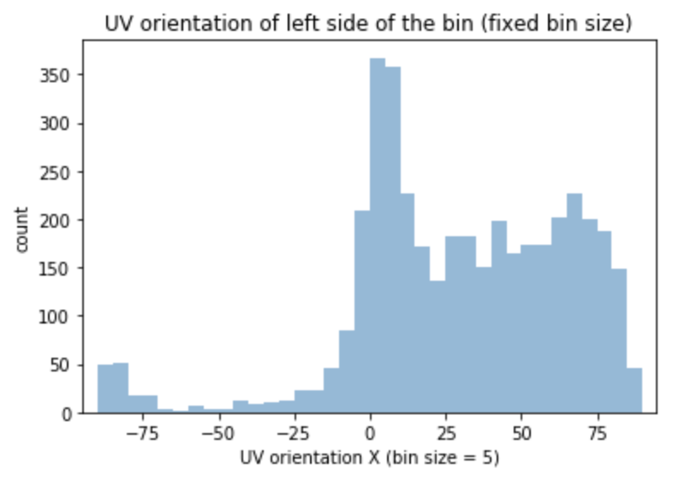
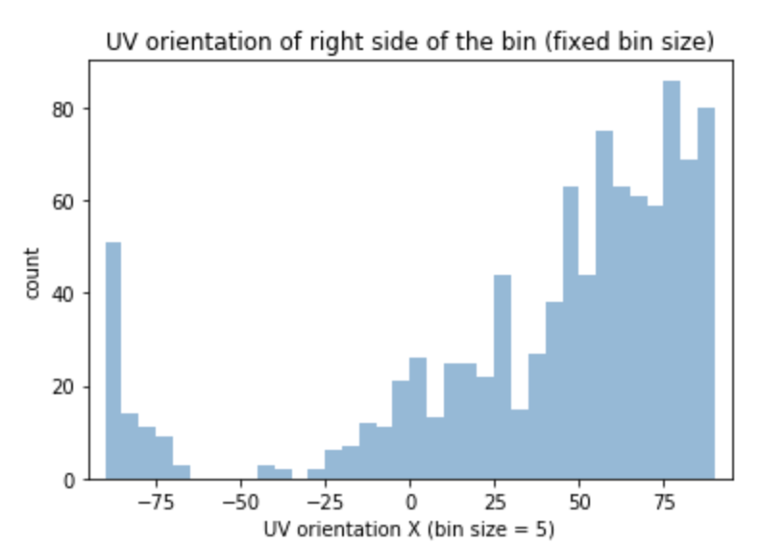
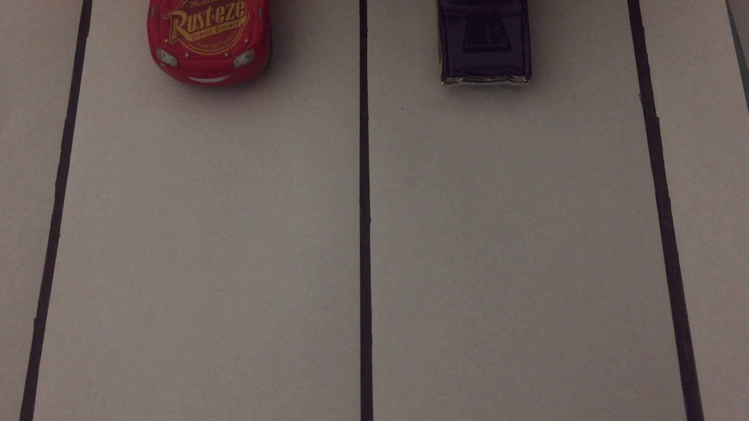
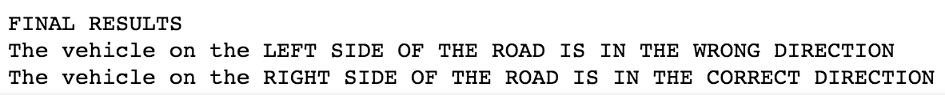

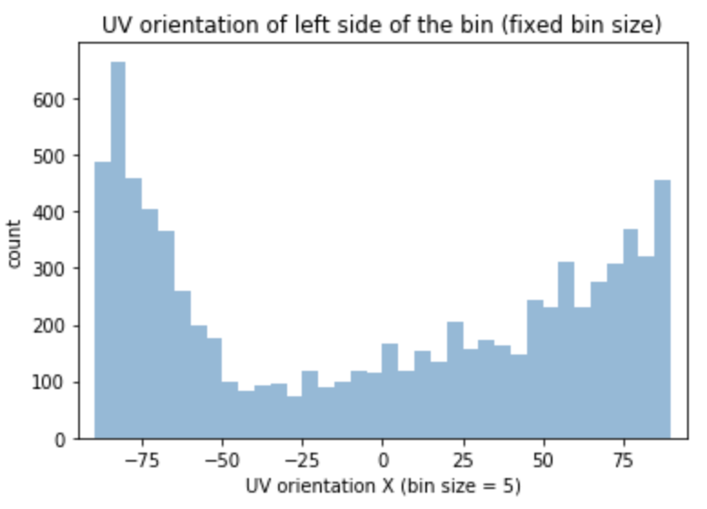
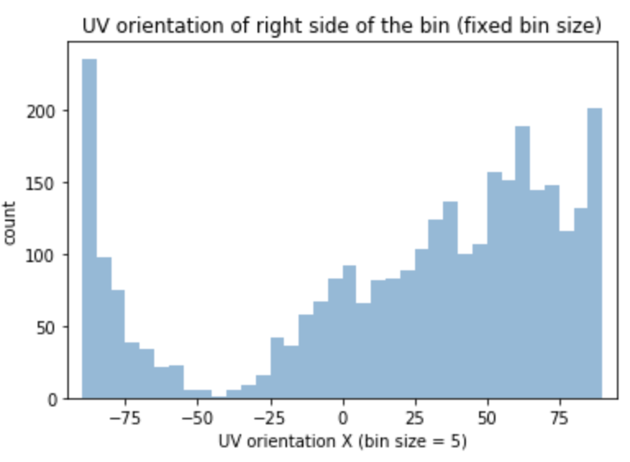
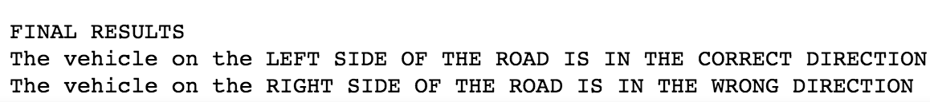
OTHER RESULTS
Expected: Left Side of the road: Wrong Direction
Right Side of the road: Correct Direction
Expected: Left Side of the road: Correct Direction
Right Side of the road: Wrong Direction

Slide 27
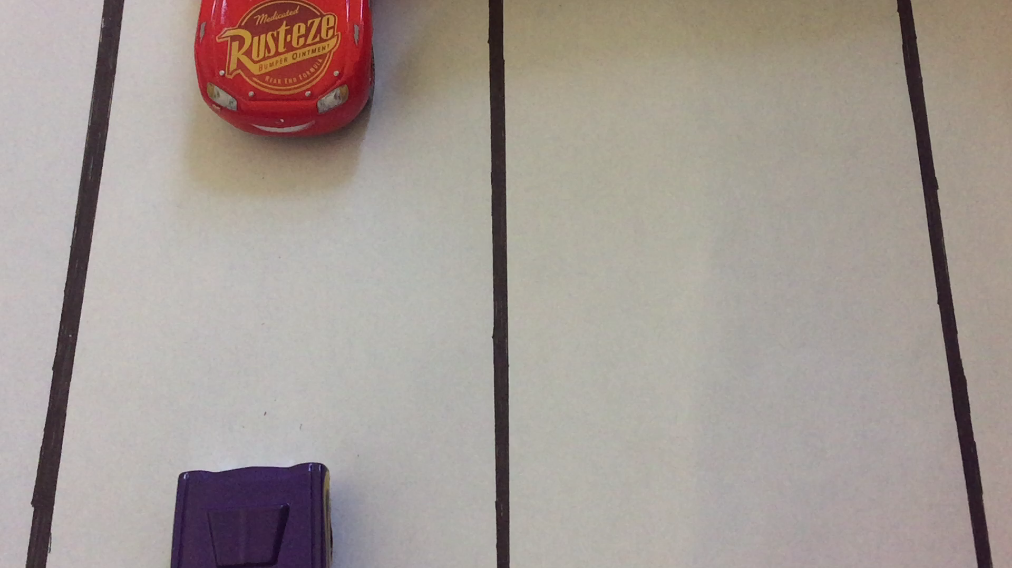
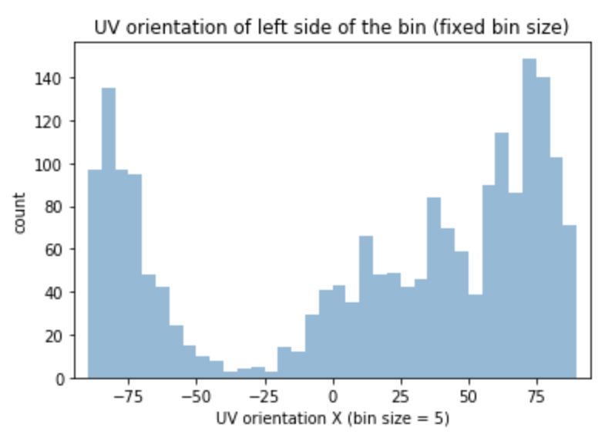
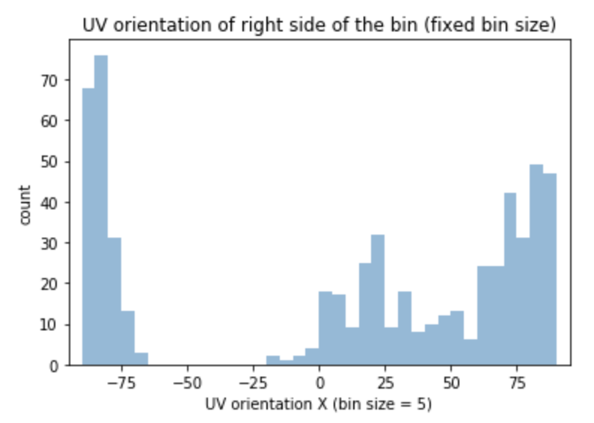

CASE WHICH FAILS AND ITS SOLUTION
Explanation about Right side of the road:
We could find that degrees were plotted on this side of the road because there is shadow movement of the
experimenter when we were doing this experiment
Explanation about Left side of the road:
We could find that degrees were plotted on positive side and negative side of the graph because there
was movement of vehicles in both the direction. We got the result as wrong direction because the surface of
the red car is more so more plots were plotted with respect to that objects optical flow
Solution: Reduce the scope of the camera so that it can capture only a single car body and not multiple objects

Slide 28
THANK YOU

